Slide 1
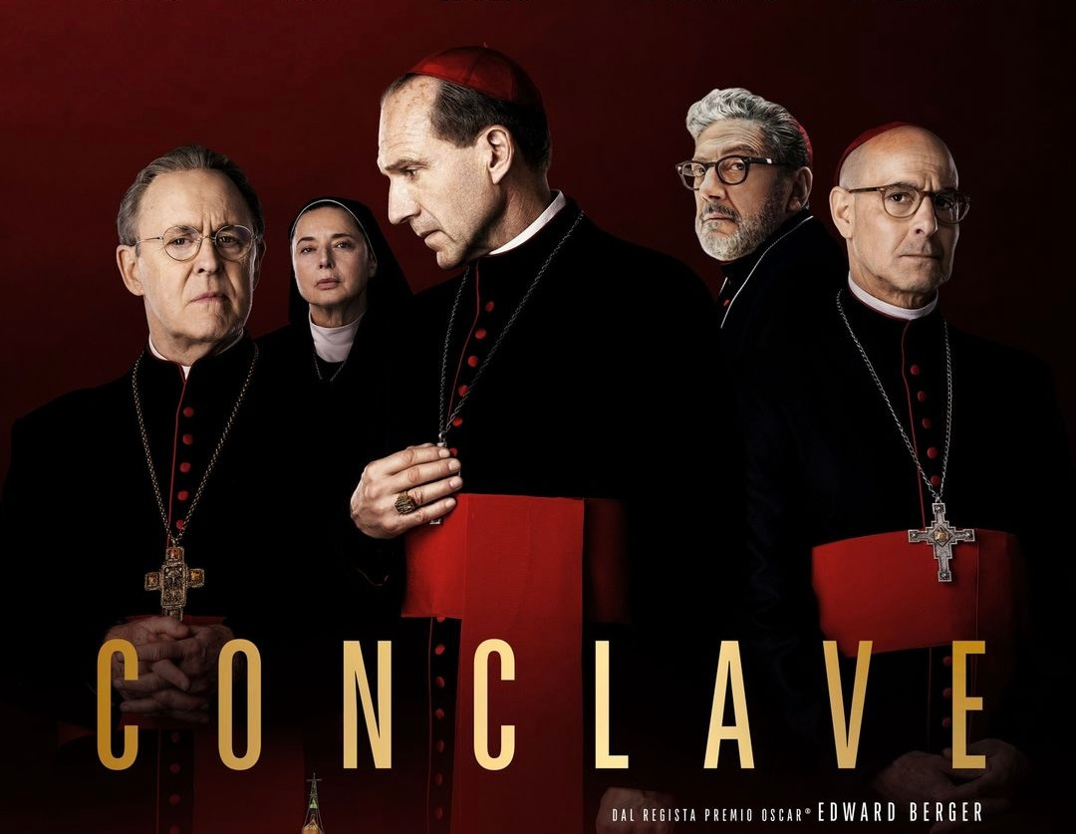



UNLOCKING CONCLAVE’S PATH TO OSCAR GLORY
DATA-DRIVEN MARKETING INSIGHTS FROM ROTTEN TOMATOES REVIEWS
ELENA CONDERANA & SERGIO CUENCA

Slide 2

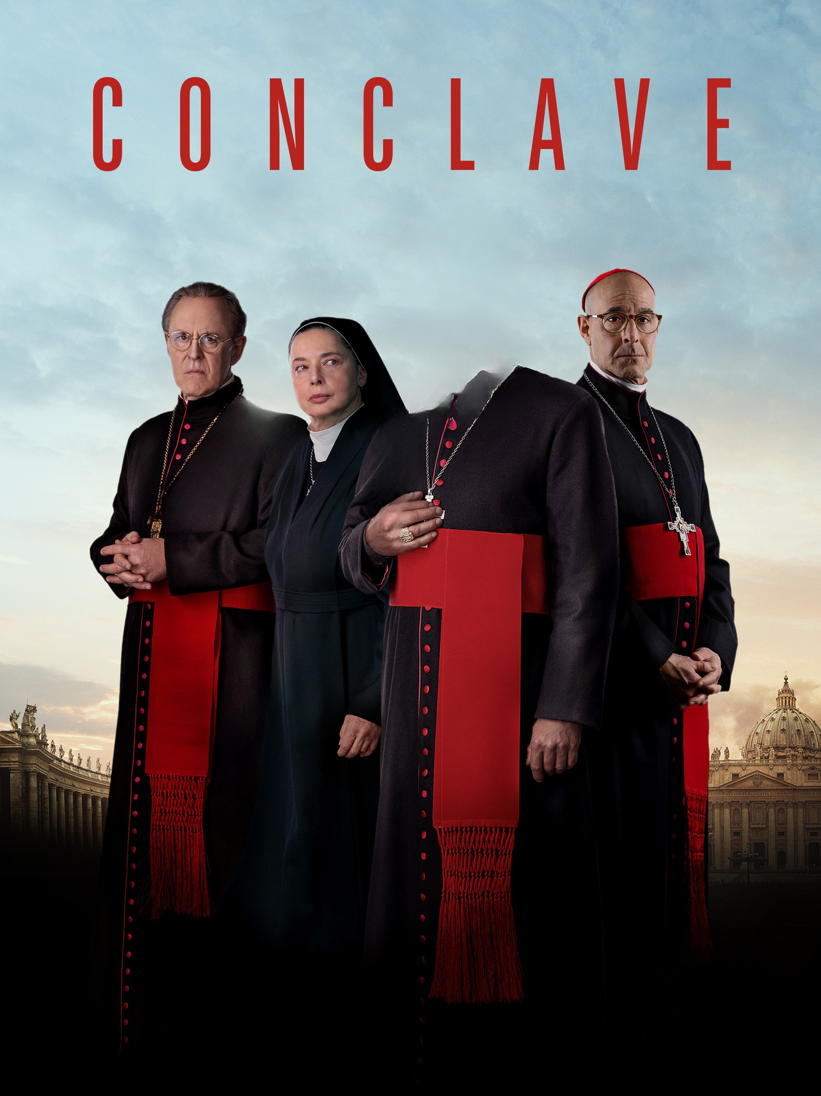

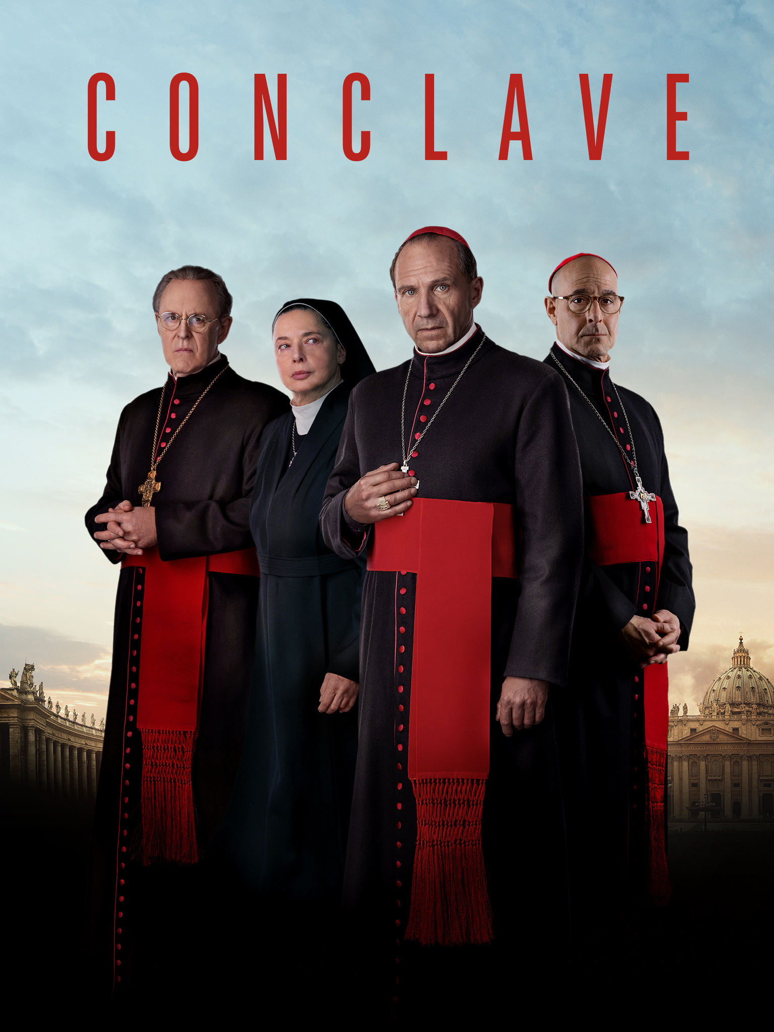
01
Data Collection
02
Data Cleaning & Processing
CONTENTS
03
Gained Insights. Marketing Strategies
04
Conclusions & Next Steps
2

Slide 3
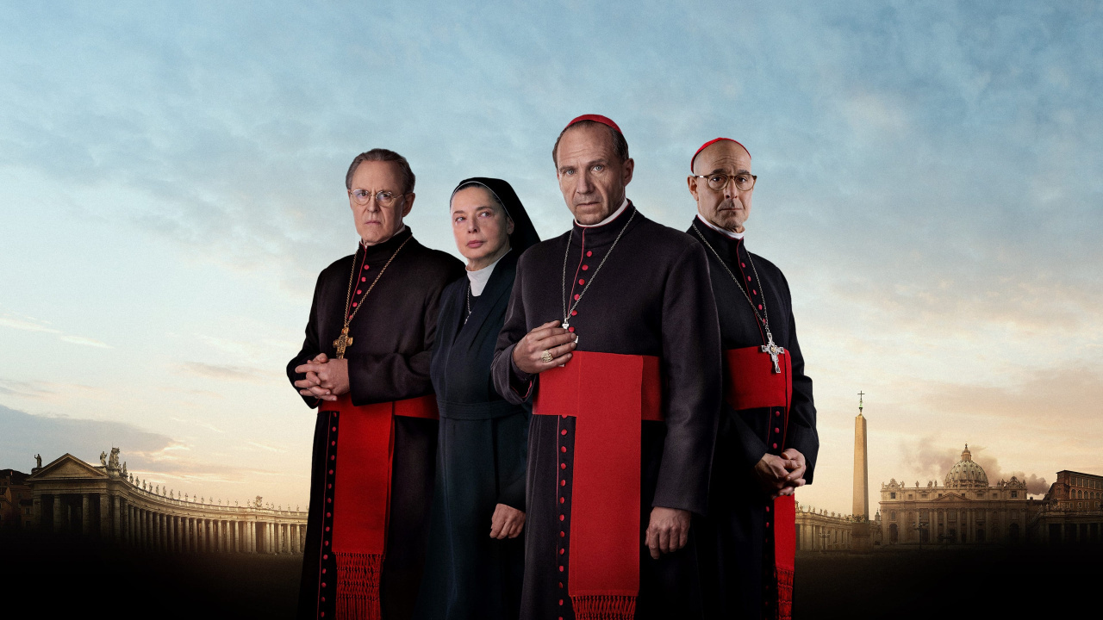
DATA COLLECTION
DATA-DRIVEN MARKETING INSIGHTS FROM ROTTEN TOMATOES REVIEWS

Slide 4
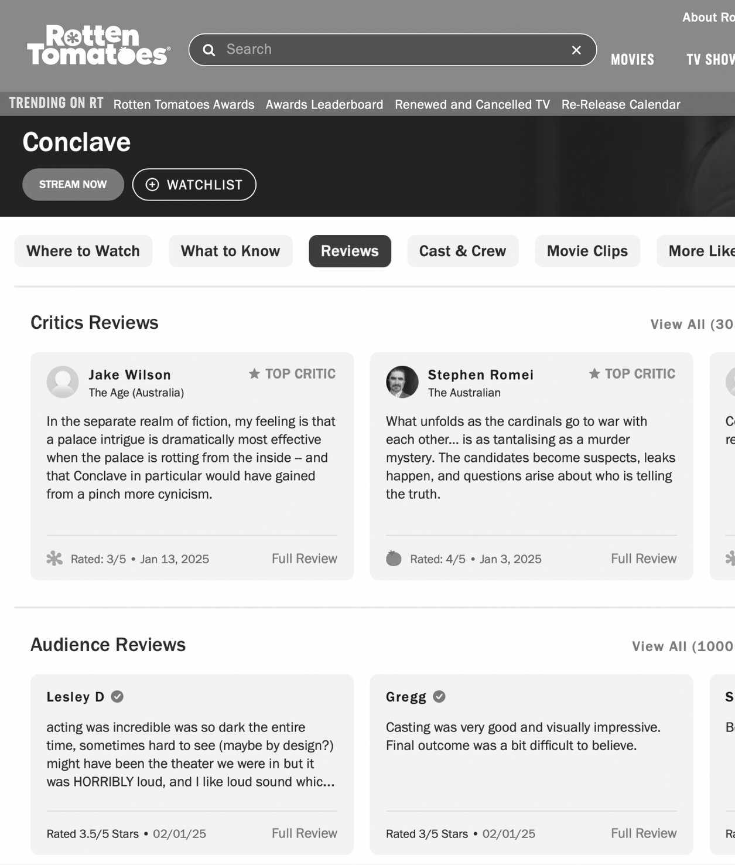
DATA COLLECTION
EXTRACTING AUDIENCE & CRITICS REVIEWS
Web Scraping - Rotten Tomatoes
Scraping Approach:
Selenium: Handles dynamic elements.
BeautifulSoup: Extract structured data from the HTML (critic names, publications, scores, and review texts).
Pagination & Error Handling: Ensured up to 250 reviews per category (critics & audience) while avoiding duplicates.
Storing Data in MongoDB Atlas
Remote accessibility & shareability.
Scalable for large datasets.
Secure with automatic backups.
Database Structure
Each review is stored as an object containing:
Reviewer type (Critic/Audience)
Reviewer name
Publication (for critics only)
Date of review
Score (if available)
Review text
4

Slide 5
2. DATA CLEAN. & PREP.
DATA-DRIVEN MARKETING INSIGHTS FROM ROTTEN TOMATOES REVIEWS

Slide 6


DATA CLEANING & PREPARATION
ENSURING DATA QUALITY
Removing Duplicates & Handling Missing Data
Duplicate Reviews: Used sets to track reviews that had already been seen. This prevents scraping the same review multiple times when paginating.
Handling Missing Scores (N/A Values): Some reviews don’t contain scores, so we filtered those out when analyzing numeric trends. Reviews with missing scores were still used for sentiment analysis to avoid data loss.
Extracting Key Metadata for Analysis
Dates: Converted raw date formats into structured ISO format (YYYY-MM-DD) for proper time-series analysis.
Publications: Extracted critic affiliations to analyze how different media outlets perceive the film.
Sentiment & Scores: Used VADER to analyze sentiment for reviews.
Filtering Relevant Information
Keyword Filtering: Removed generic words to focus on meaningful themes.
Targeted Analysis: Separated audience vs. critic perspectives to shape better marketing strategies.
6

Slide 7
3. INSIGHTS & STRATEGIES
DATA-DRIVEN MARKETING INSIGHTS FROM ROTTEN TOMATOES REVIEWS

Slide 8
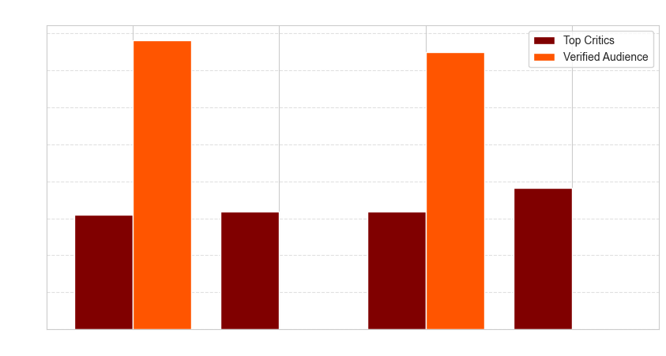
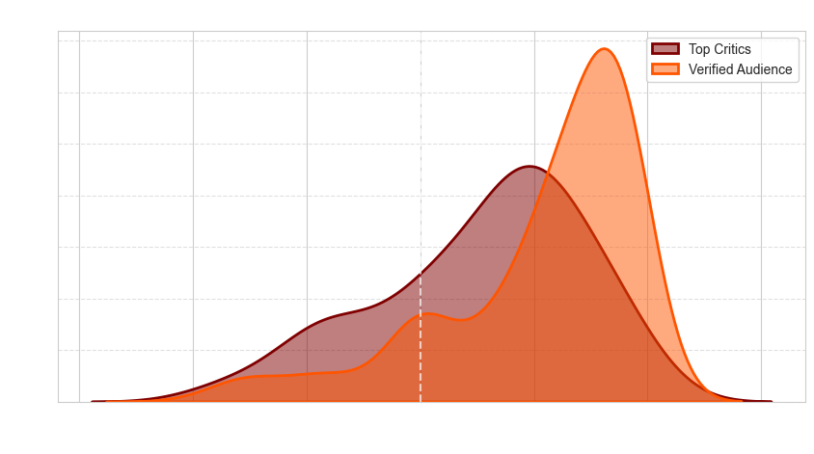
SENTIMENT ANALYSIS
HOW IS CONCLAVE PERCEIVED?
Audience Loves Fiennes & Tucci
Verified audience sentiment is overwhelmingly positive toward Ralph Fiennes and Stanley Tucci, with scores peaking near 0.8.
Fans highlight their charismatic presence, reinforcing them as key promotional figures.
Critics Show a Balanced View
Top critics are more reserved, giving moderate sentiment scores to all actors.
John Lithgow and Isabella Rossellini receive relatively higher sentiment from critics, making them stronger assets for critic-oriented campaigns.
8

Slide 9
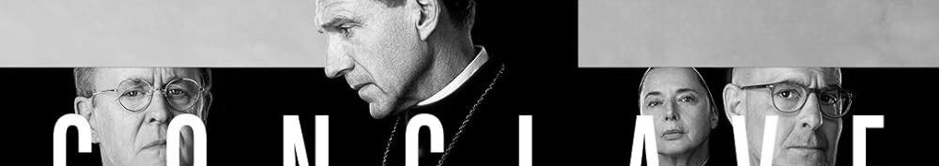






VIRAL TRUST & STAR POWER
ENGAGING AUDIENCES & CONVINCING CRITICS
1
2
3
Social Proof & Viral Trust
TikTok & Instagram Fan Reactions: Launch a "Stanley & Ralph’s Best Moments" campaign, with the audience-favorite scenes.
Meme & Quote Strategy: Share iconic quotes from their characters in a viral format.
Actor-Focused Marketing
General Audience: Focus on Ralph Fiennes & Stanley Tucci, using behind-the-scenes TikTok videos, Instagram Q&As and Late Night Shows Appearances.
Critics & Film Enthusiasts: Promote John Lithgow & Isabella Rossellini in film analysis podcasts & magazines like Sight & Sound.
Multi-Platform Strategy
YouTube Breakdown: Release a deep dive video “Why Audiences Love Fiennes & Tucci”.
Instagram Reel Series: Mini-videos comparing how audiences and critics perceive each actor.
9

Slide 10
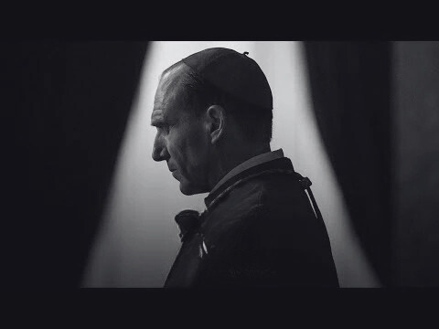
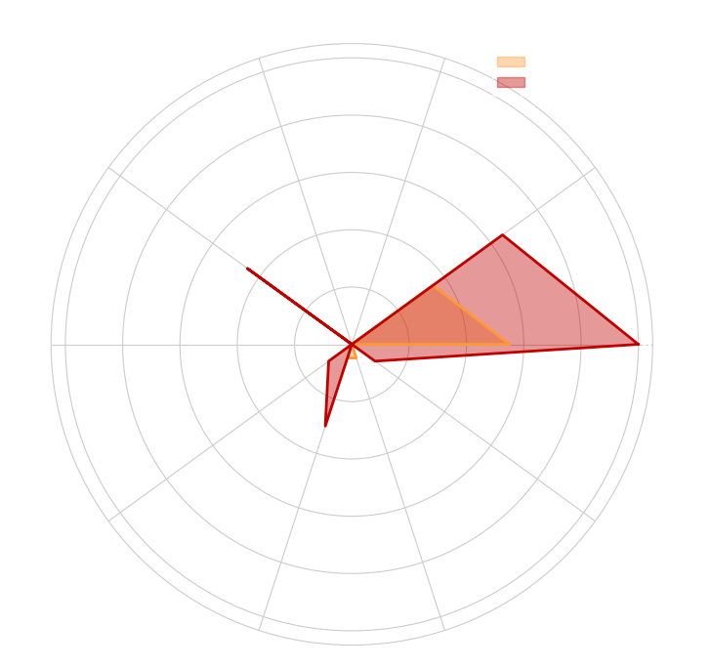
GENRE MENTIONS
WHAT ELEMENTS OF CONCLAVE STAND OUT?
Thriller & Drama Dominate
Both critics and audiences consistently reference these genres, making them the film’s core identity.
The movie is best marketed as a tense, dramatic thriller rather than a general drama.
Audiences Also Lean Towards Mystery
Their emphasis on mystery suggests they value the narrative complexity in the story.
Promotional material should lean into high-stakes moments, keeping the suspenseful tone at the forefront.
Trailer cuts focusing on key turning points can further amplify excitement.
Low Mentions of Other Genres
Action, Adventure, and Fantasy have little relevance.
Posters shouldn’t falsely portray the film as action-driven—it thrives in psychological and dramatic tension, not fast-paced spectacle.
10

Slide 11





MAXIMIZING GENRE APPEAL
AMPLIFY THE THRILLER & DRAMA APPEAL ON SOCIAL MEDIA
1
2
3
Visual Identity & Branding
Instagram & TikTok Posters: Dark, moody, shadow-heavy visuals with the appealing taglines that evokes mystery and tension.
YouTube & Streaming Thumbnails: Red & black color themes, intense character expressions to enhance mystery.
Content Strategy for Engagement
Short-form Video Clips: Share tense, cliffhanger-like moments on Instagram Reels & TikTok, prompting users to watch the full movie.
Hashtag Campaigns: Use hashtags like to align with audience expectations and promote virality.
Targeted Advertising
Sponsor content on True Crime & Thriller Podcasts (e.g., Crime Junkie, The Ringer's Big Picture).
YouTube Ad Placement before videos analyzing thrillers, mystery films, and drama breakdowns.
11

Slide 12
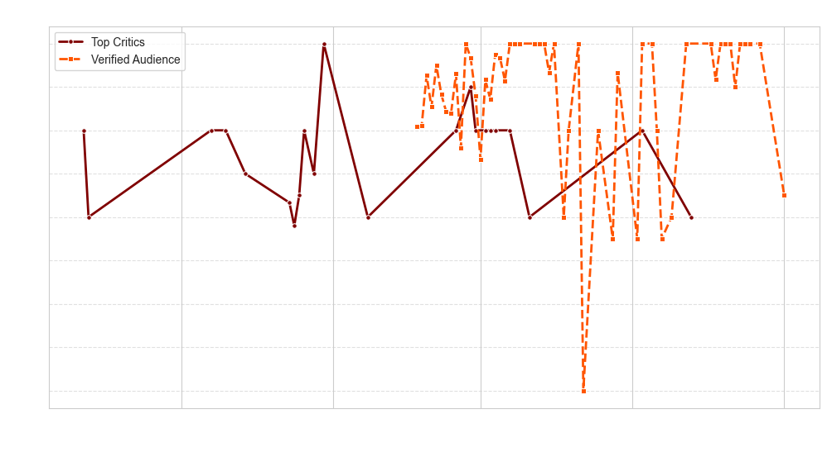
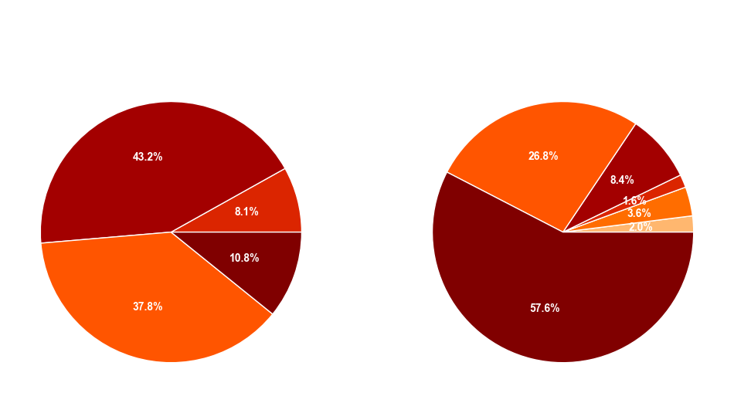
SCORE EVOLUTION & DISTRIBUTION
THE STORY OF CONCLAVE’S RECEPTION & WHO RATES CONCLAVE HIGHER?
Score Evolution Over Time
Audience ratings remain high, indicating strong word-of-mouth appeal.
There are spikes in enthusiasm, suggesting key moments when the film gained traction in discussions.
Score fluctuations highlight the importance of timing promotions strategically.
Audience vs Critics
Audience scores are more enthusiastic, with most ratings at 4 or 5 stars, showing stronger emotional engagement.
Critics are more reserved, often rating the film 3 or 4 stars, focusing on technical aspects like pacing, screenplay, and direction.
12

Slide 13




AMPLIFYING AUDIENCE HYPE
TURNING VIEWERS INTO MARKETERS
1
2
3
Lean into User-Generated Content
Launch a TikTok & Instagram campaign featuring fan reactions, reviews, and favorite scenes.
Feature testimonials like “Rated 5 stars by the majority of viewers!”
Time-Sensitive Marketing Blitz
Identify high-score spikes and push TV & online ads during these periods.
Collaborate with influencers & film YouTubers for live reviews.
Launch a limited-time promotional screening event tied to audience hype.
Engage Users with Dilemmas
“Who Do You Trust?” Campaign: Frame audience debates over the film’s key moral dilemmas (What would you do if you had to choose the next Pope?).
13

Slide 14
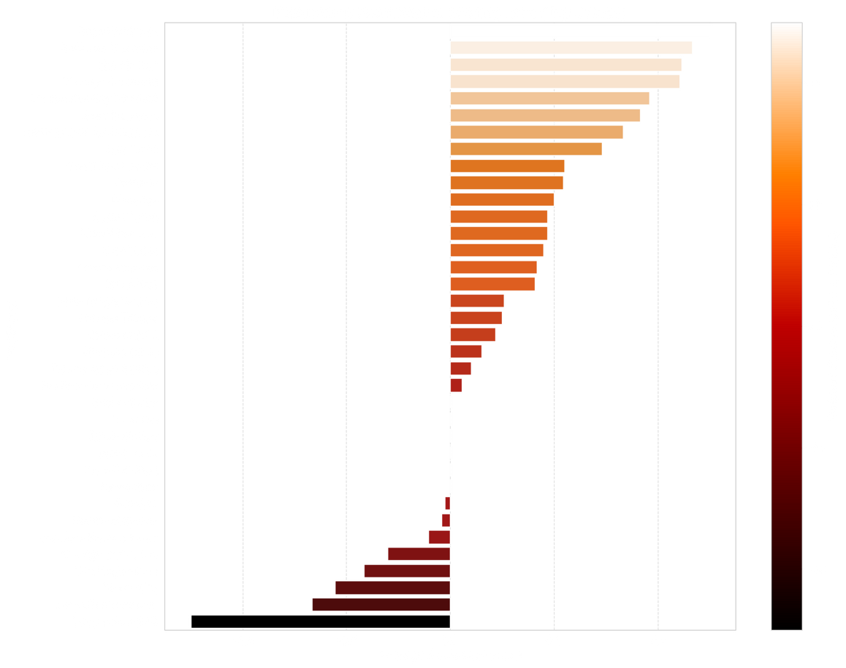
PUBLICATION BIAS
WHO SUPPORTS CONCLAVE THE MOST?
Regional Divide in Critical Reception
UK media are significantly more negative, with 5 of the 10 lowest sentiment scores coming from British publications.
Only 1 of the 10 most positive reviews originates from a UK media outlet.
6 of the most positive reviews come from US-based critics, showing a more favorable outlook.
While the US has mixed reactions, there is a stronger positive tendency compared to the UK.
Even within the most negative US reviews, the criticism appears more moderate, whereas UK outlets are noticeably harsher.
14

Slide 15





WINNING OVER THE UK MARKET
OVERCOMING REGIONAL SENTIMENT GAPS TO STRENGTHEN GLOBAL APPEAL
1
2
3
Strategic UK Press & TV Coverage
Rebuilding UK perception with high-profile media: Secure cast interviews in BBC One, The Guardian, and Empire Magazine.
Organize a London Film Premiere with exclusive Q&A sessions
Increased Accessibility & Partnerships
Early streaming deals with Amazon Prime UK, Sky Cinema, or BBC iPlayer.
Host special UK screenings in major cities (London, Manchester, Edinburgh) with Q&A panels featuring the cast and director.
Targeted UK Ad Strategy
Adapt UK-focused ad campaigns that emphasize the intrigue elements, aligning with the British genre preferences.
Address common criticisms raised by UK media in interviews and promotions to reshape public perception.
15

Slide 16
4. CONCLUSIONS
DATA-DRIVEN MARKETING INSIGHTS FROM ROTTEN TOMATOES REVIEWS

Slide 17
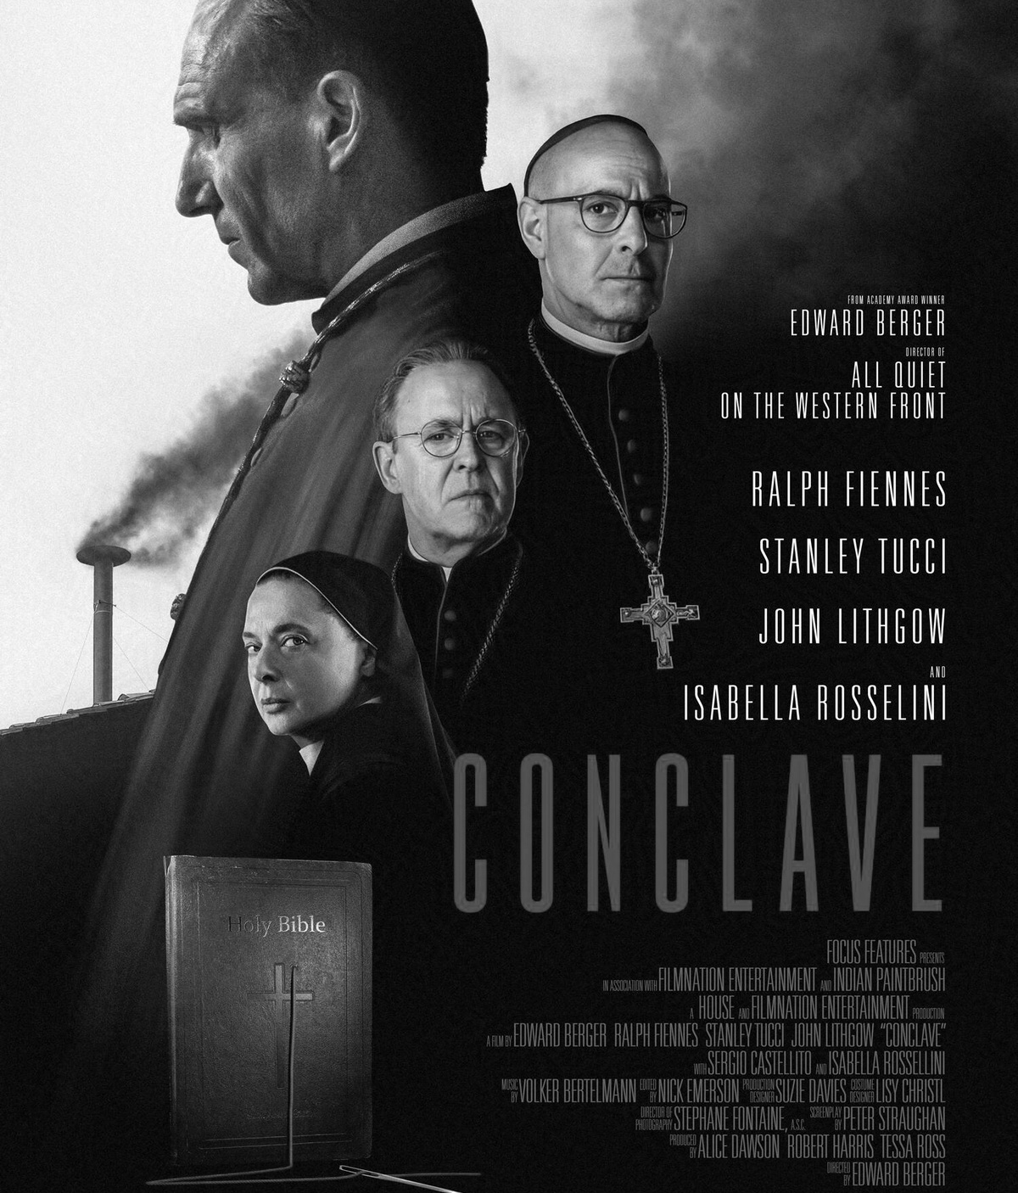
CONCLUSIONS
Marketing Must Be Adaptive
Social proof & audience trust drive virality (TikTok, Instagram, YouTube UGC).
Timing matters: Score spikes align with peak engagement moments, ideal for ad campaigns.
UK perception is a challenge: Needs targeted outreach, local screenings & media push.
Winning Strategy for Conclave
Capitalize on audience enthusiasm: Make viewers the promoters.
Strategic critic engagement: Elevate positive reviews, refine perception.
Maximize thriller & drama appeal: Align branding with genre expectations.
Leverage cross-platform promotions: Social media + traditional media + influencer collabs.
Conclave has the potential for long-term success if it strategically leverages audience hype, refines critical perception, and maximizes its genre appeal across platforms.
17

Slide 18
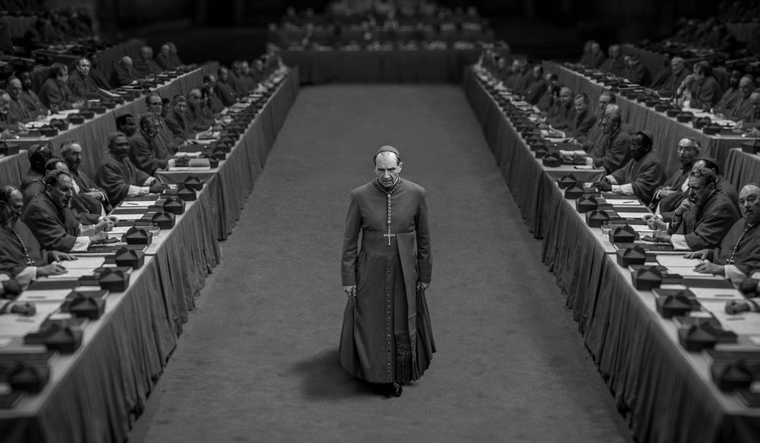
THANK YOU!
ELENA CONDERANA & SERGIO CUENCA

